Slide 1



Notes:
Good morning. With immense pleasure I take this opportunity to welcome the peer team Members to our college. On behalf of the management, staff and students, I extend a very warm welcome to the distinguished Chairperson of the peer team. I also extend a hearty well to Member secretary
With kind permission from the Chair and the member, I would like to take you through the presentation.

Slide 2
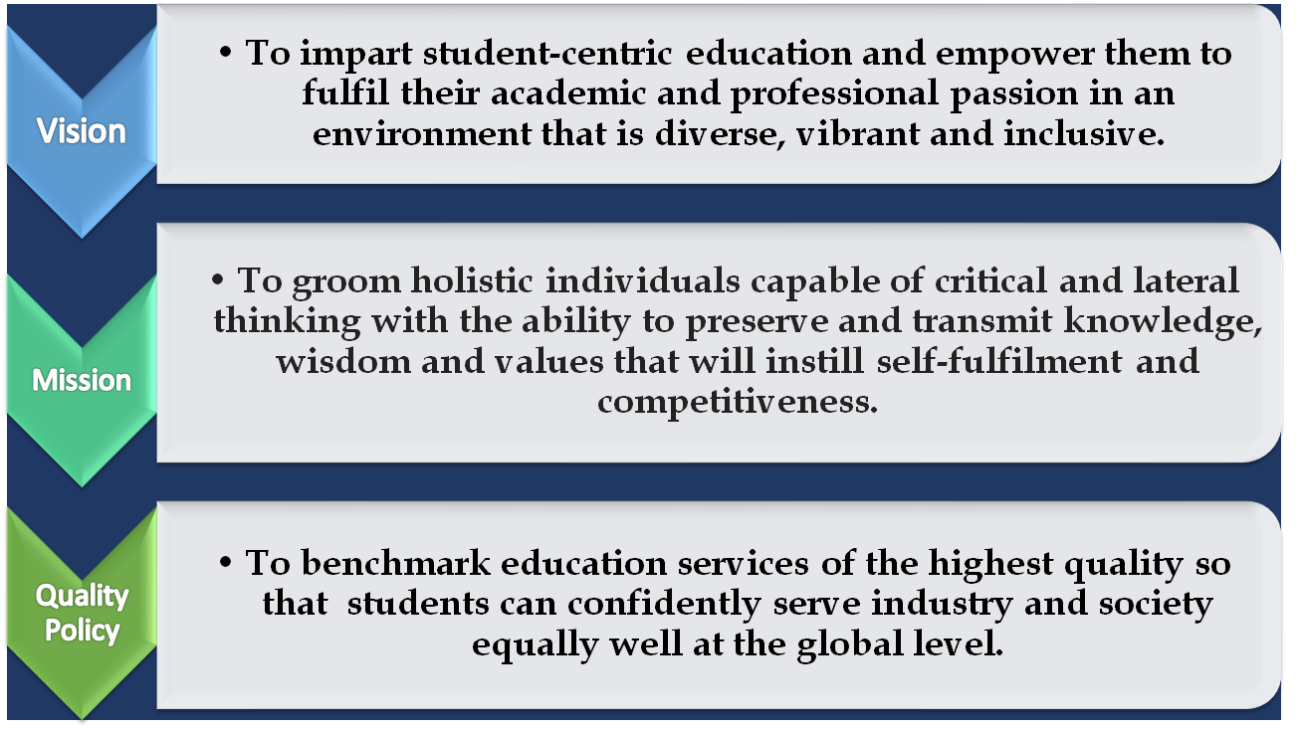

Slide 3

Programmes Offered @ NHC
UG
BBA
BCOM
BCA
In Three Different Streams-
Executive
Professional
Global Certification
Value added programs are imparted by industrial experts as a unique value addition to the students of the college

Slide 4
Bachelors of Business Administration
Offered under three Different Streams
Executive- This program enables students to earn a degree certificate from Bengaluru North University
Professional- Along with the degree, students gain industry-ready skills through value-added programs.
Global Certification- Gain a competitive edge with Global Certification, making student more attractive to employers.

Slide 5
BACHELOR OF BUSINESS ADMINISTRATION
Digital Marketing an Social Media
Artificial Intelligence in Business
Cybersecurity for Business
MS Excel, Word & Power Point Presentation Workshop
Foreign Language- French, German, Japanese
National Industrial Visit
CMA - Certified Management Accountants-International Institution Certificate-USA
Business Analytics-Global Certification-UK
Digital Marketing & E-Commerce- Global Certification
Executive Stream
with
Global Certification
Value Added Program-Professional Stream

Slide 6

Why BACHELOR OF BUSINESS ADMINISTRATION….?
The Bachelor of Business Administration is a dynamic Programme that develops the students’ potentials of being leaders, entrepreneurs, academicians as well as researchers in the field of business/business education.
The main objective of this program is To foster global competencies among students so that they may pursue careers in management and excel in different fields.

Slide 7
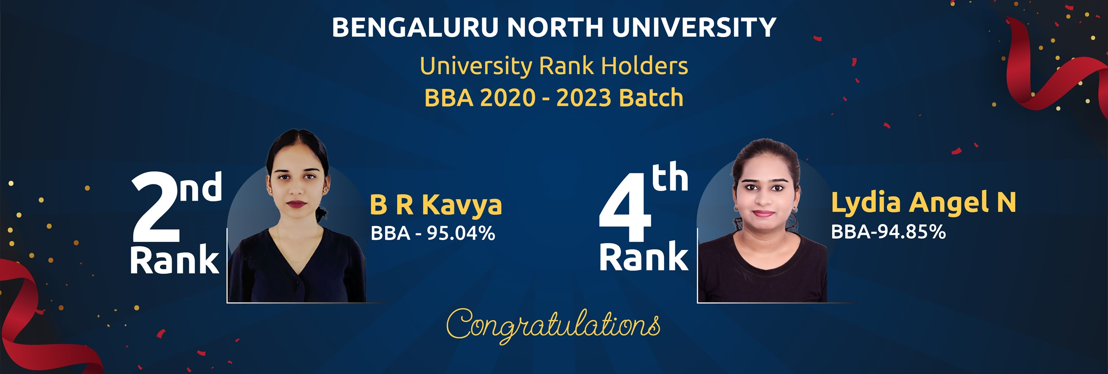

Slide 8




CAREERS AFTER BACHELOR OF BUSINESS ADMINISTRATION
HR Recruiter
HR Generalist
HR payroll
Training &Development Manager
HR & Admin
Financial Analyst
Business Analyst
Audit Assistant
Tax Analyst
Risk and Assurance Analyst
Investment Banking
Project Controller( Budget)
Finance Manager
Financial Controller
Chief Financial Officer
Marketing Associate
Marketing Coordinator
Market Research analyst
Business Development Executive
Relationship Manager
Event Manager
Public Relations
Ad-agency roles
Brand manager
Retail manager

Slide 9
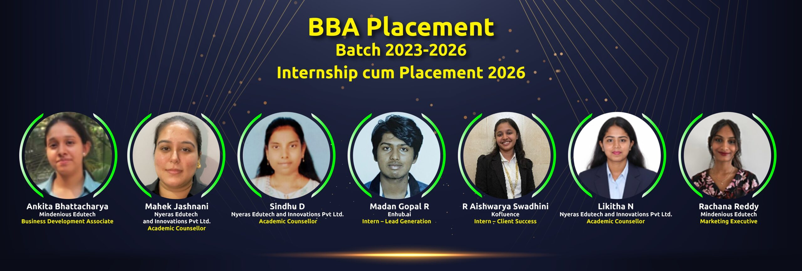

Slide 10
Bachelors of Commerce
Offered under three Different Streams
Executive- This program enables students to earn a degree certificate from Bengaluru North University
Professional- Along with the degree, students gain industry-ready skills through value-added programs.
Global Certification- Gain a competitive edge with Global Certification, making student more attractive to employers.

Slide 11
BACHELOR OF COMMERCE
CA Foundation
Digital Marketing an Social Media
Artificial Intelligence in Business
Cybersecurity for Business
MS Excel, Word & Power Point Presentation Workshop
Foreign Language- French, German, Japanese
National Industrial Visit
ACCA-Association of Chartered Certified Accountants-International Institutional Certificate UK
Business Analytics-Global Certification
Digital Marketing & E-Commerce- Global Certification
Executive Stream
with
Global Certification
Value Added Program-Professional Stream

Slide 12
Why BACHELOR OF Commerce….?
This Programme initiates the students into the principles and practices of advanced accounting and the dynamics of management, marketing, banking, auditing, company law, secretarial practice and allied disciplines. This degree is designed to develop excellent analytical skills, which are valuable to decision-making in the areas of business, finances, banking, taxes and the economy at large.
The main objective of this program is Improving accounting skills and developing business acumen through quality teaching-learning process, mentoring and counseling of students.

Slide 13
CAREERS AFTER BACHELOR OF COMMERCE
Accounts and Taxation
CA, ICWA, CPA, ACCA etc
Tax Analyst, Tax Assessment Officers.
Developing new Accounting Packages and Software.
Audit Controllers, Public Sector Bank Managers etc
Finance
Investment Banking
Stock Broking and Portfolio Management
Venture Capital Roles
Self Start Up Business.
Banking and Insurance
Banking Jobs in Public and Private Banks.
Valuation Officers
Jobs in Public and Private Insurance Companies
Actuaries ( Insurance)
Development Officers in LIC and GICs
Insurance Underwriters etc

Slide 14


Slide 15
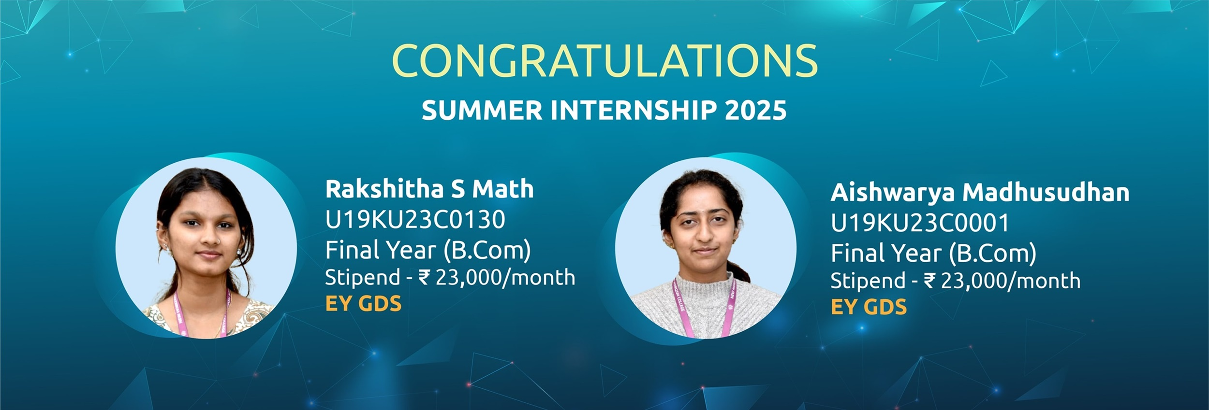

Slide 16
Bachelors of Computer Applications
Offered under three Different Streams
Executive- This program enables students to earn a degree certificate from Bengaluru North University
Professional- Along with the degree, students gain industry-ready skills through value-added programs.
Global Certification- Gain a competitive edge with Global Certification, making student more attractive to employers.

Slide 17
BACHELOR OF COMPUTER APPLICATIONS
Generative AI
Cybersecurity Essentials and Ethical Hacking
Human-Computer Interactions with UX/UI Design specialization
Cloud Computing with AWS or Azure
MS Excel, Word & Power Point Presentation Workshop
Foreign Language- French, German, Japanese
Cyber Security & Digital Forensic- Global Certification
Digital Marketing & E-Commerce- Global Certification
AWS & CCNA- Global Certification
Executive Stream
with
Global Certification
Value Added Program-Professional Stream

Slide 18
Why BACHELOR OF COMPUTER APPLICATIONS….?
The BCA degree prepares the students for manpower requirement of the fast developing IT/Software industry. Students who join the department of BCA at the college come from varied backgrounds.
The objective of this program is to e ncourage students to become self-driven, problem solving individuals who can find and understand the knowledge needed to be successful in the profession & to impart updated technical education and knowledge.

Slide 19


Slide 20



CAREERS AFTER BACHELOR OF COMPUTER APPLICATIONS
Software Developer
Web Developer
Mobile App Developer
Game Developer
Data Analyst
Database Administrator
Big Data Engineer
Cybersecurity Analyst
Network Administrator
Ethical Hacker

Slide 21
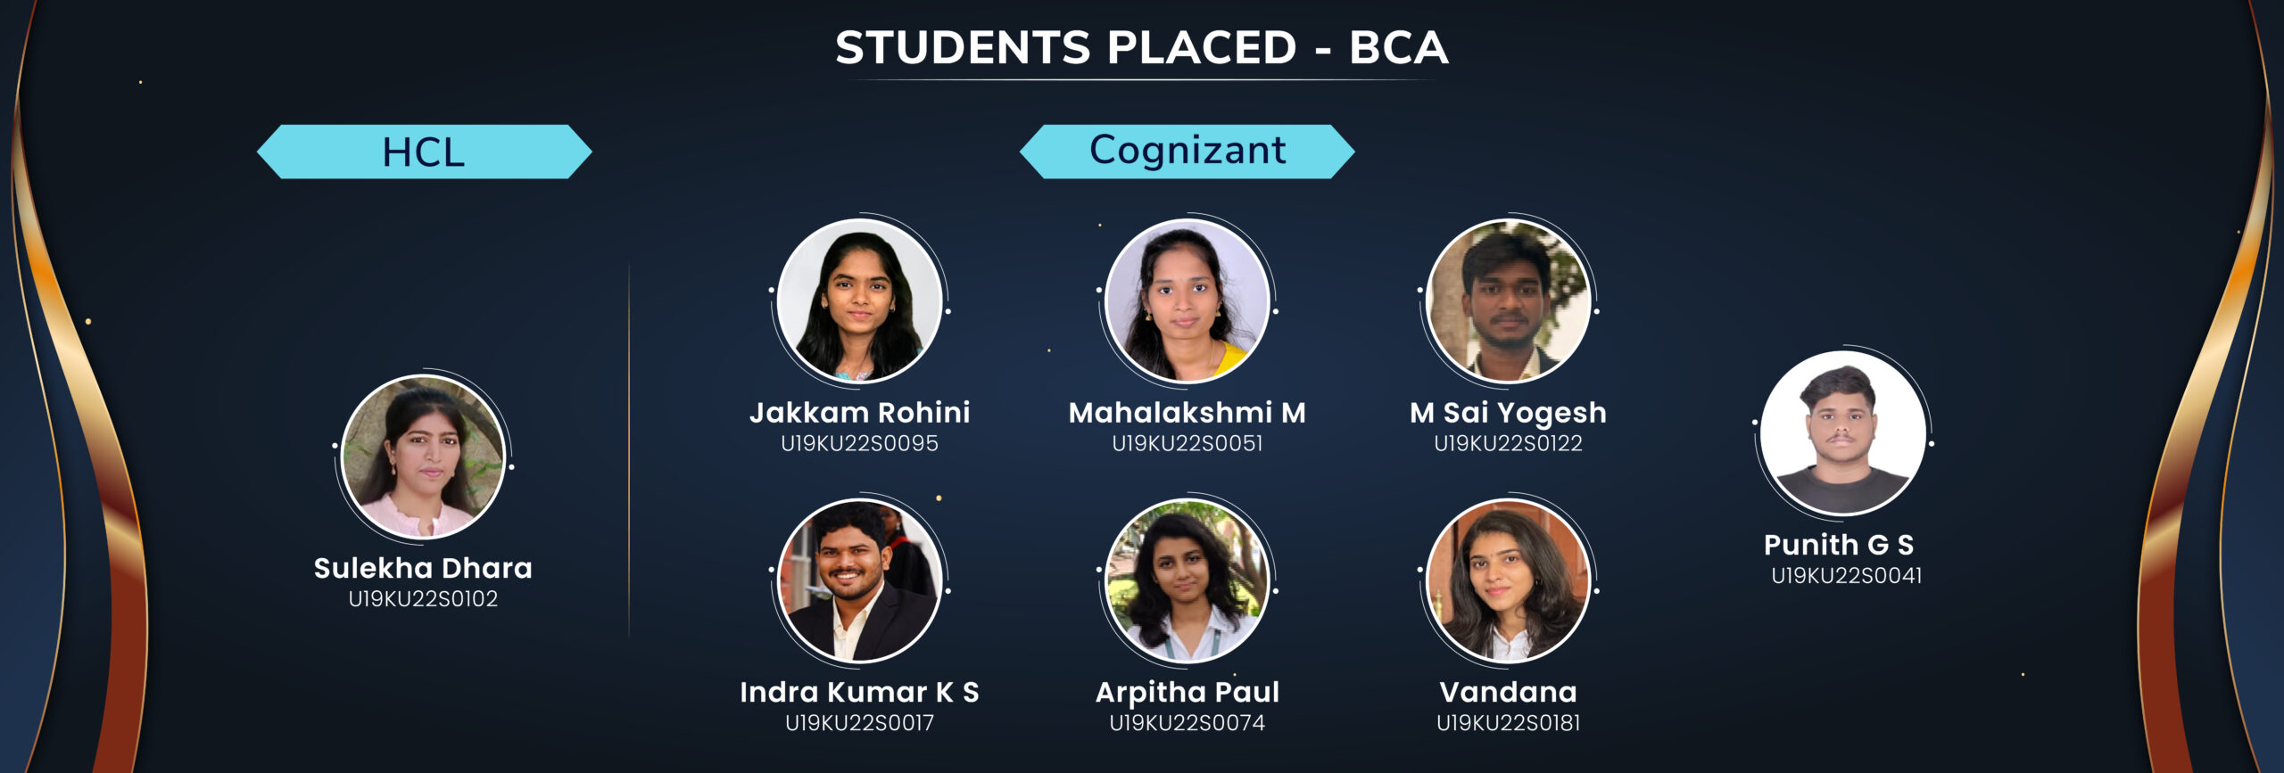

Slide 22


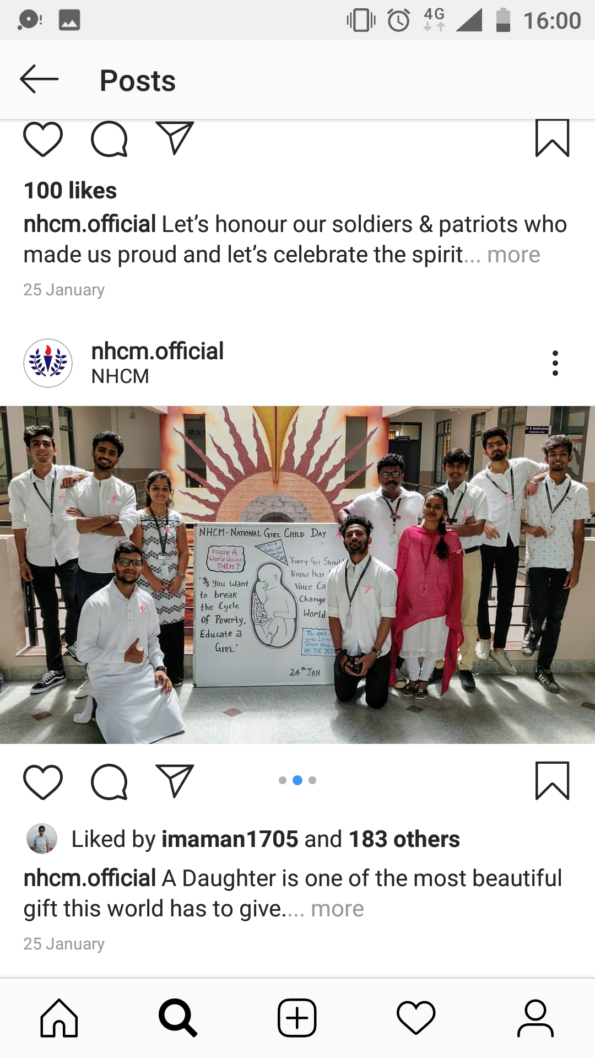


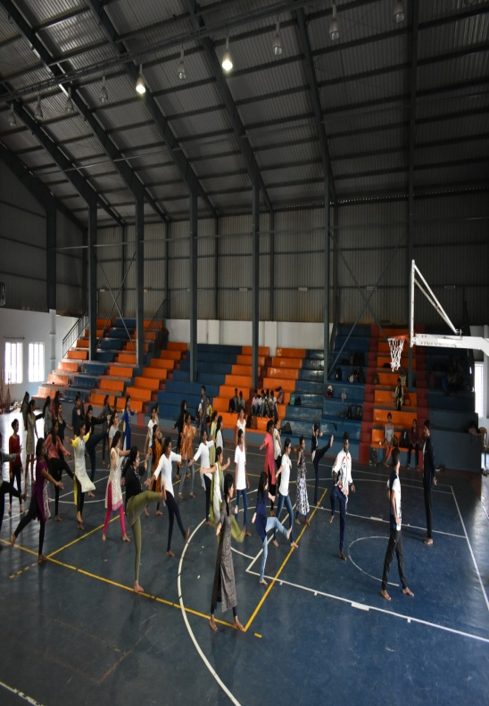
Integrating Cross-Cutting Issues Gender Equality & Women Empowerment
Notes:
Integration of programs relating to cross cutting issues into the curriculum to sensitize students relating to gender issues, workshop on self defence specially to female students and various other programs are a common feature of the curriculum.

Slide 23
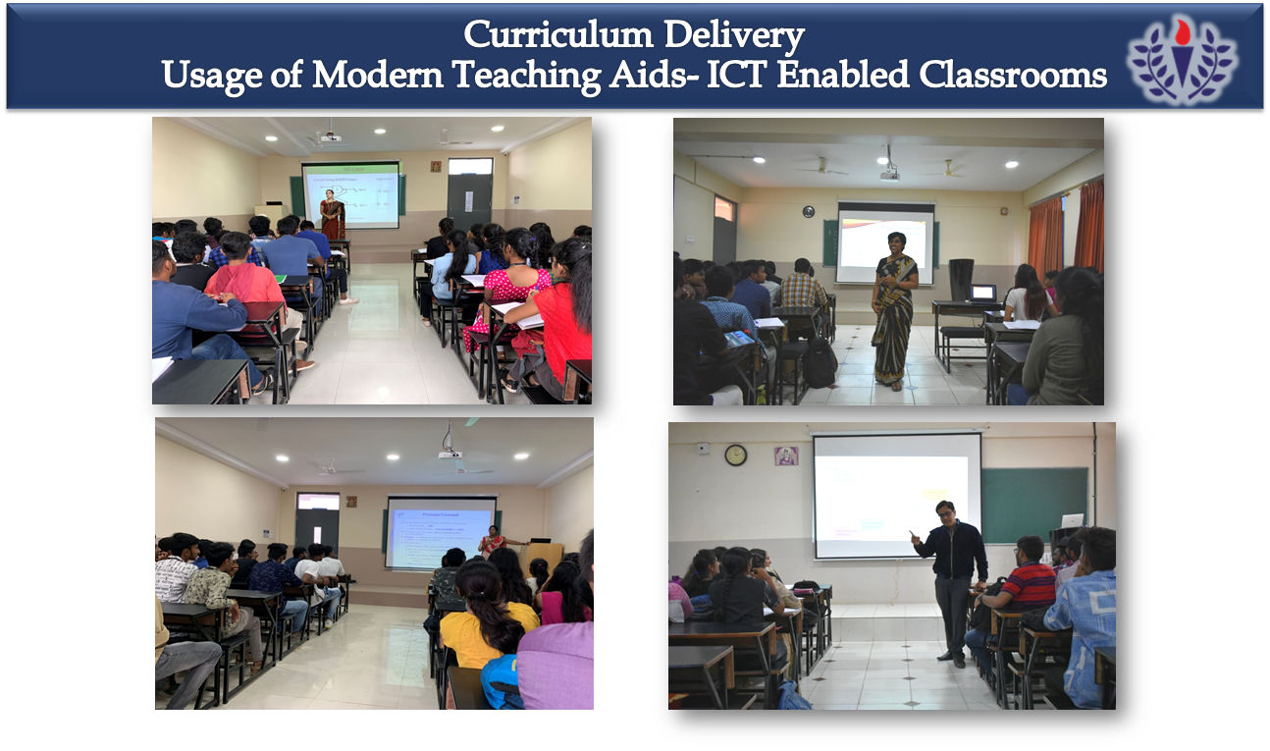
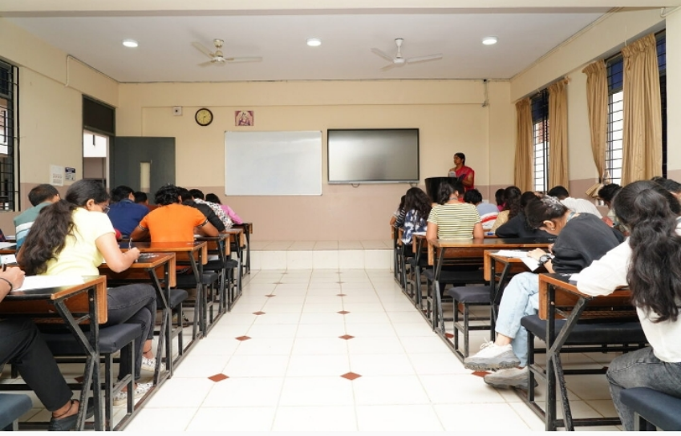

Slide 24
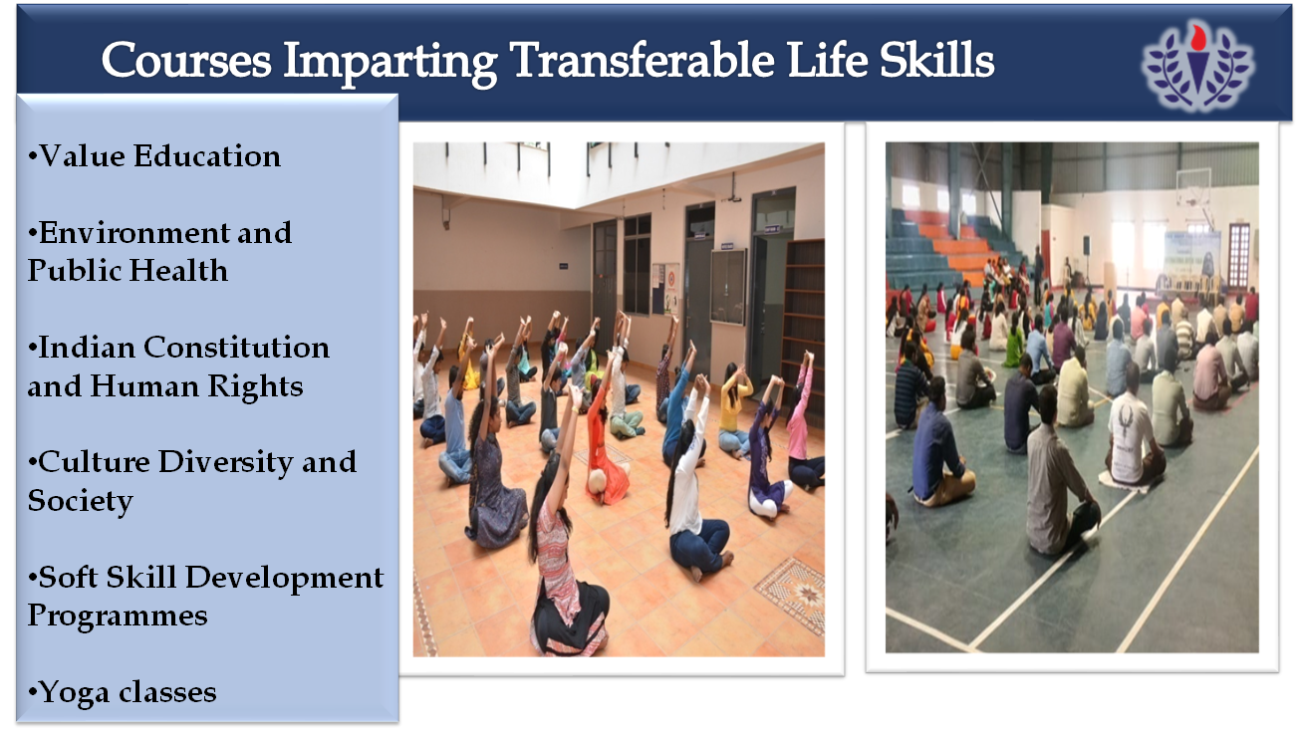

Slide 25
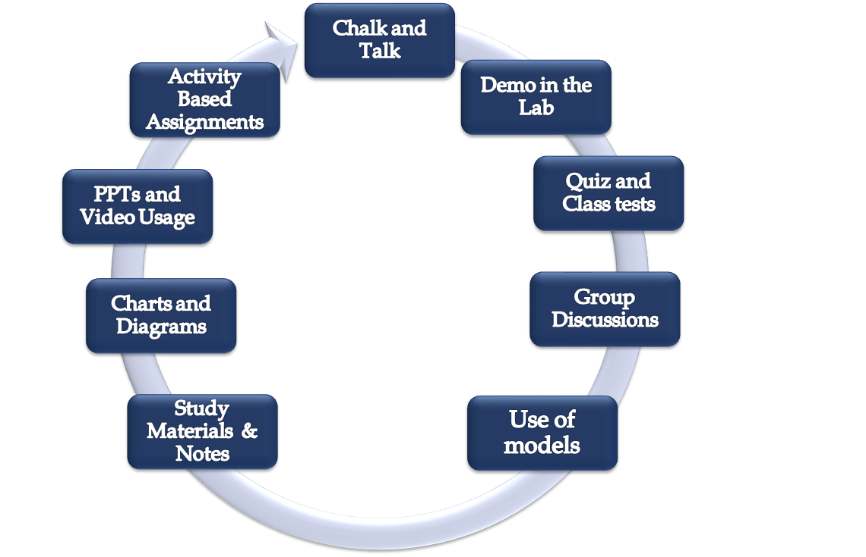
Innovation And Creativity In Teaching-Learning

Slide 26

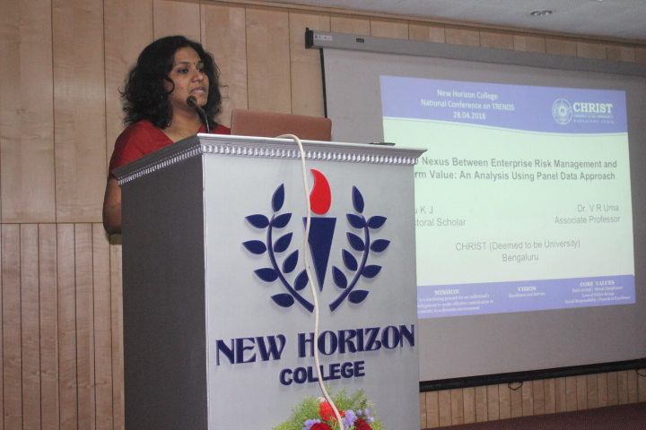
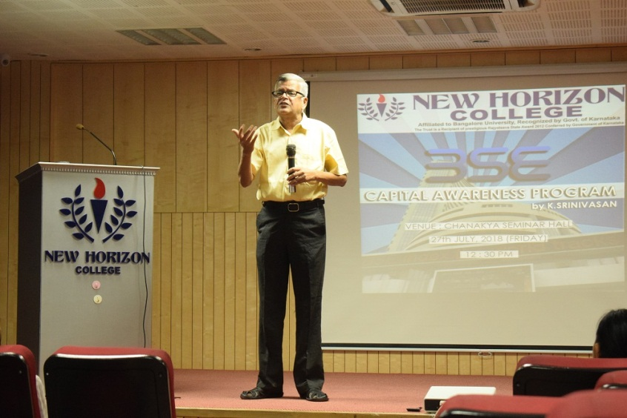
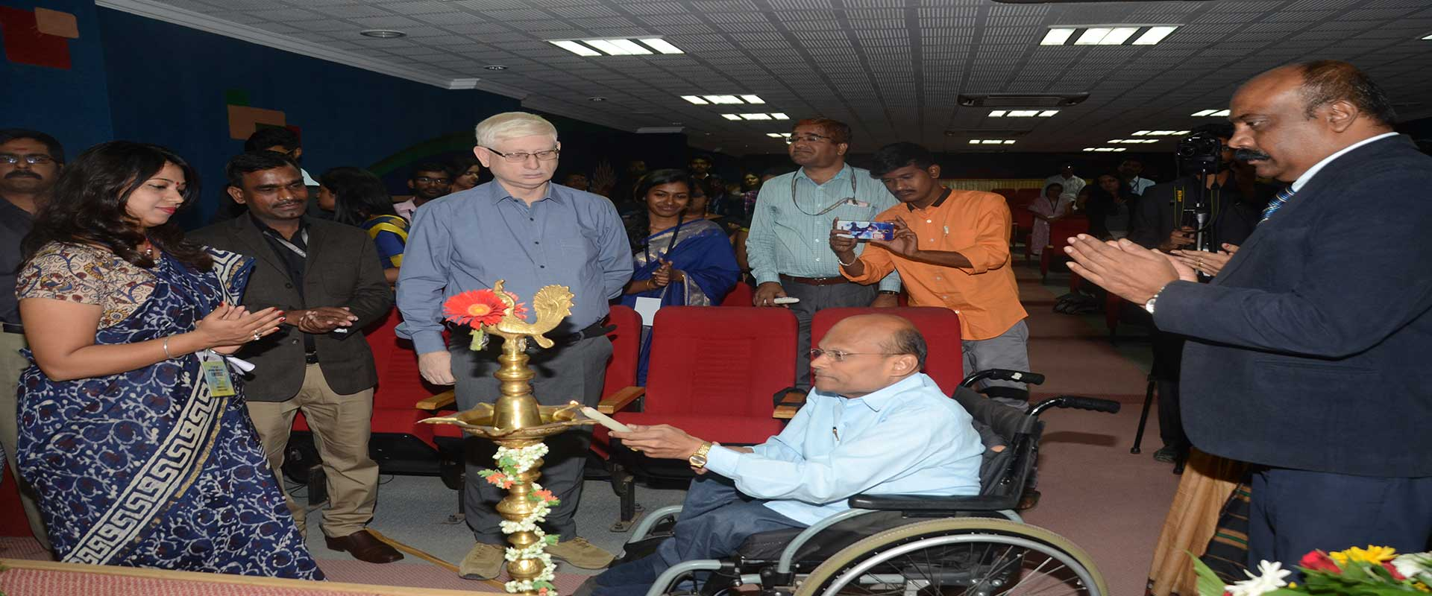
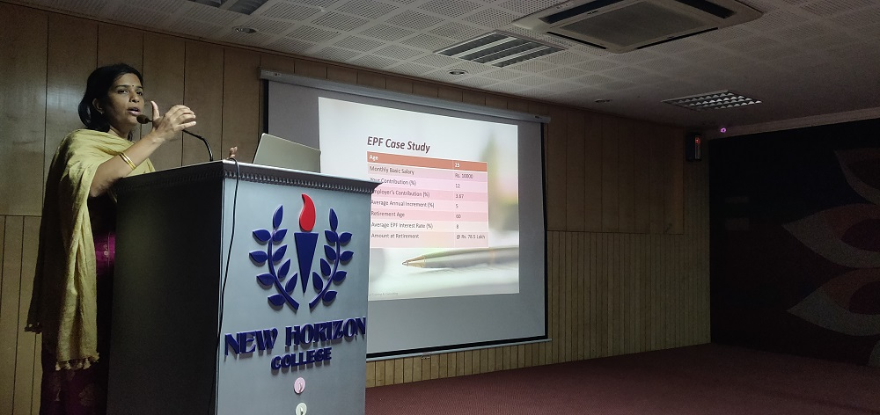
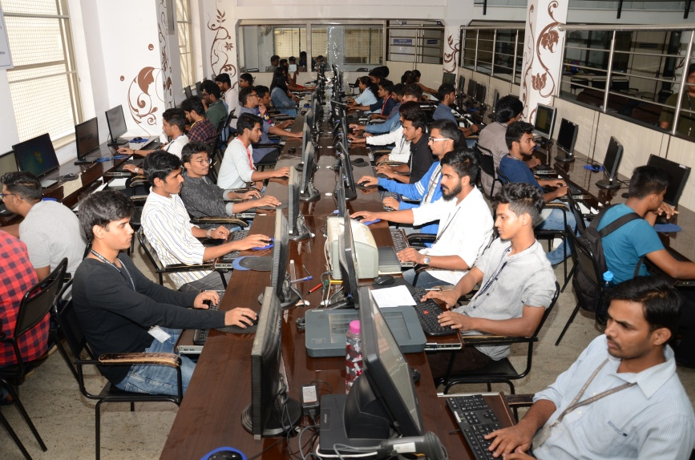
Innovation and Creativity in Teaching-Learning Experiential Learning
National Conference
Industry Interaction
National Conference
Guest Lectures
Hands-on Training

Slide 27
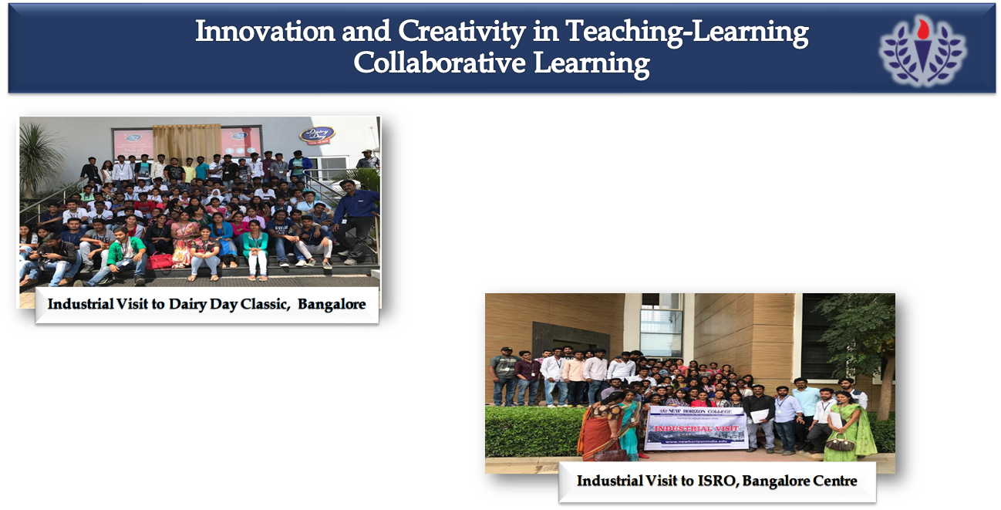
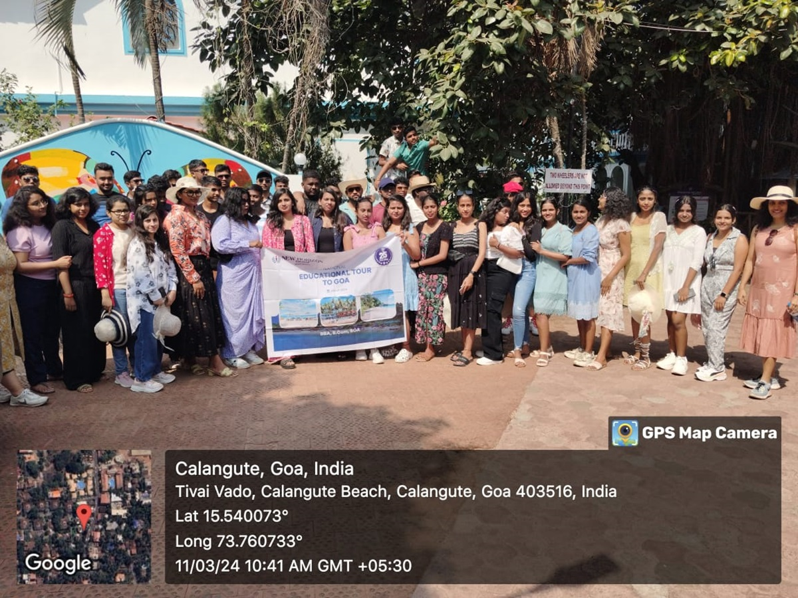
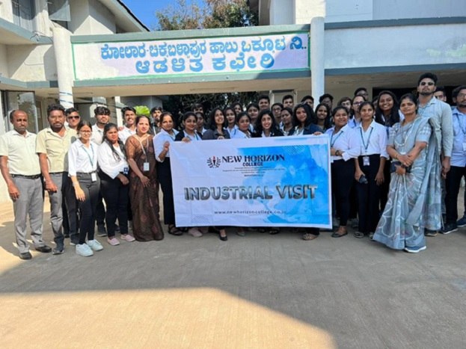
INDUSTRIAL VISITS
National Educational Tour, GOA
Industrial Visit to Kolar Milk Factory

Slide 28
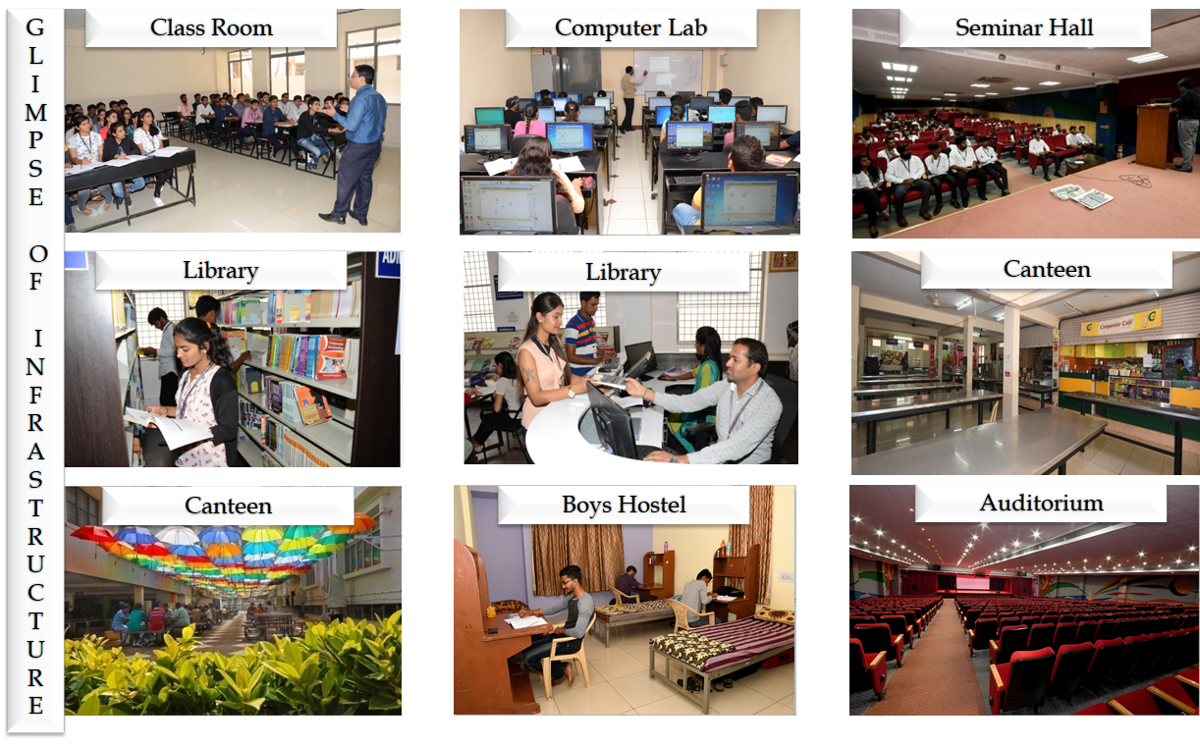

Slide 29


Slide 30
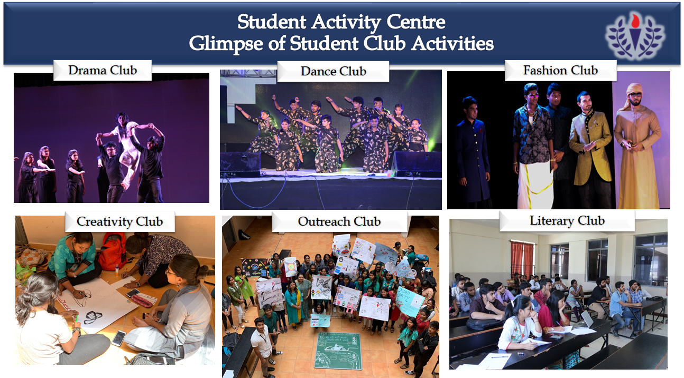

Slide 31
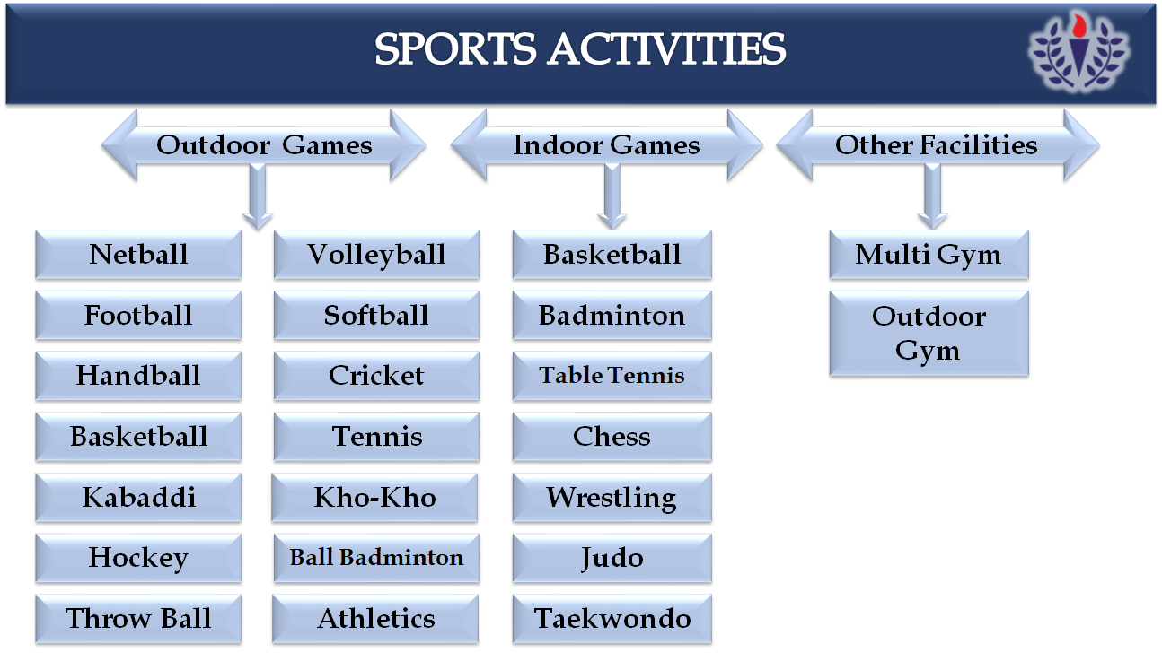

Slide 32


Slide 33
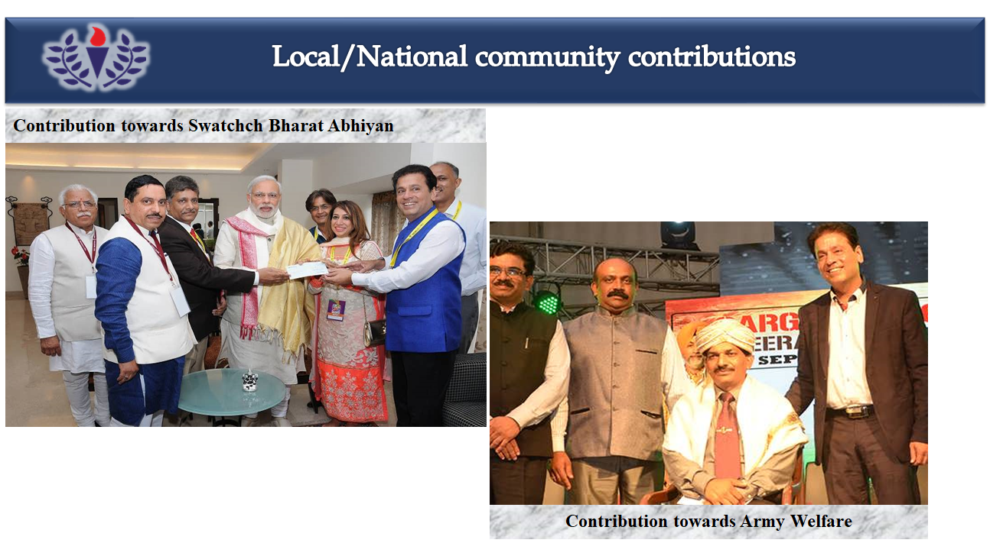

Slide 34


Slide 35


Slide 36
THANK YOU

